Slide 1

Exploratory Data Analysis(EDA)

Slide 2
About me
My name is Magbuwe Vera Ogheneovo
I am a Chemical Engineering Student at the University of Benin, Edo State, Nigeria and I am currently doing my undergraduate internship I have always loved Tech and my interest as always been machine learning / data science
Linkedin: https://www.linkedin.com/in/vera-magbuwe-b60a4423b
Github: www.github.com/vera-magbuwe

Slide 3
Agenda
The dataset contains the employment outcomes of engineering graduates as dependent variables (Salary, Job Titles, and Job Locations) along with the standardized scores from three different areas – cognitive skills, technical skills and personality skills. The dataset also contains demographic features. The dataset contains around 39 independent variables and 3998 data points. The independent variables are both continuous and categorical in nature. The dataset contains a unique identifier for each candidate. Below mentioned table contains the details for the original dataset.
Exploratory Data Analysis:
Data cleaning
Univariate analysis
Bivariate analysis

Slide 4
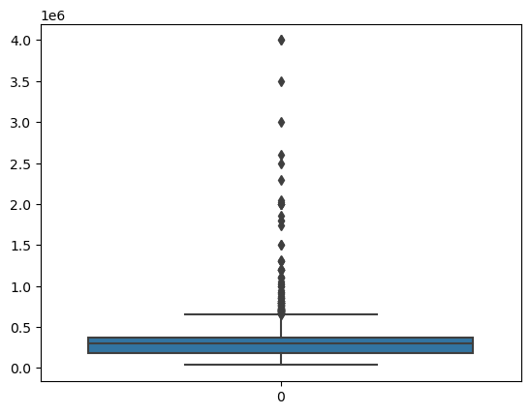
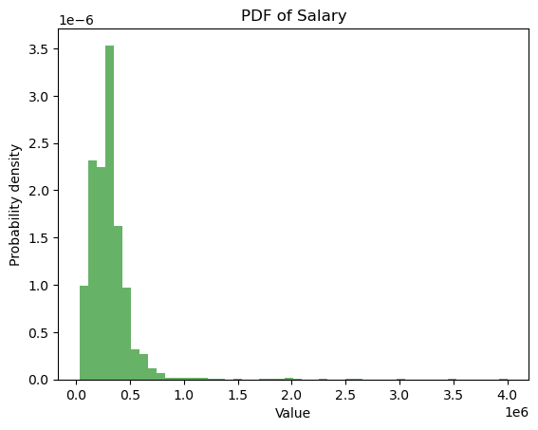
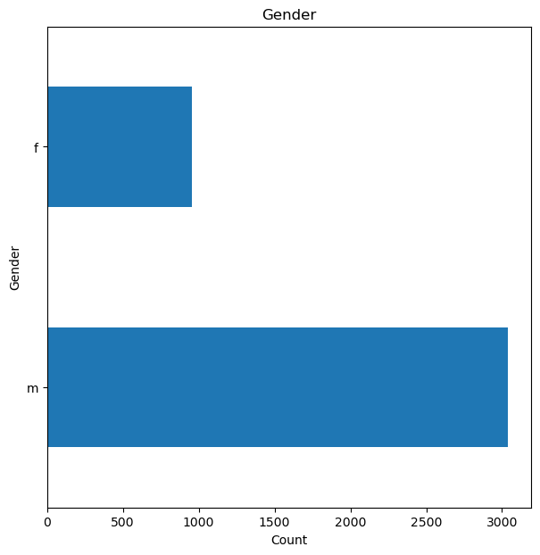
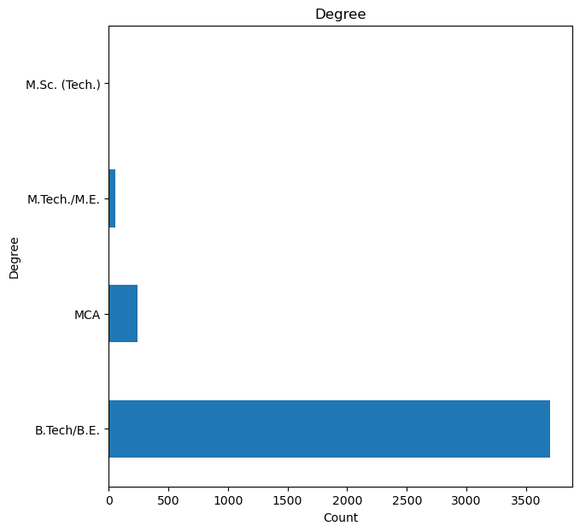
Univariate Analysis
Numerical
The salary ranged from 35,000 to 4,000,000 and most employees are paid around 300,000.
The salary column also has a lot of outliers
Categorical
There are way more males than females
Majority of the employees graduated with a B.Tech/B.E, studied electronics/computer engineering and studied at uttar pradesh

Slide 5
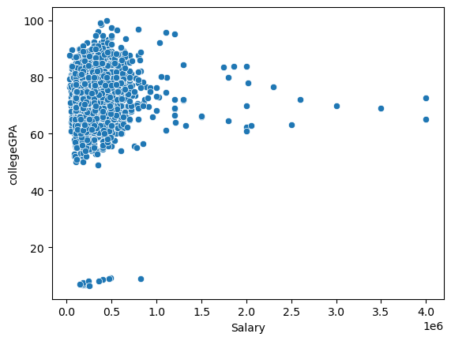
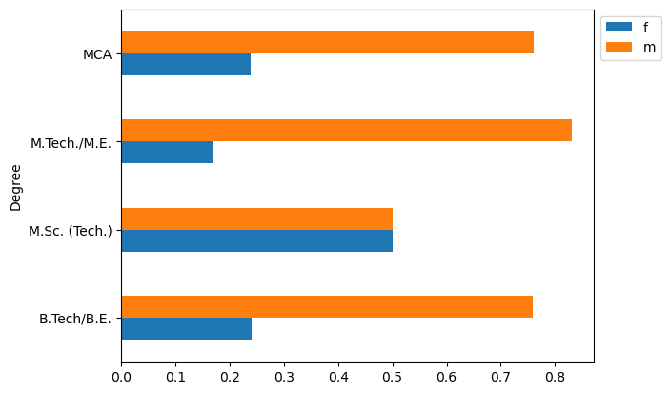
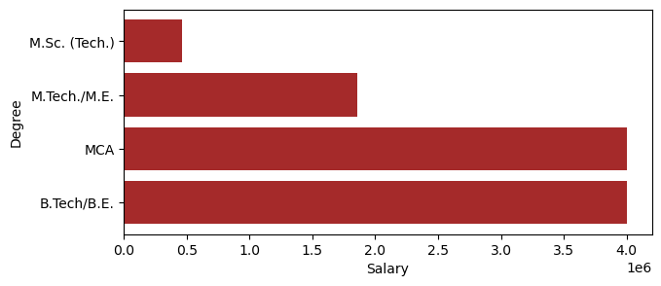
Bivariate Analysis
Numerical vs Numerical
Categorical vs Categorical
Only graduates with a gpa above 40 are employed, the others can be seen as outliers
The number of males getting a degree are higher than females but equal for M.Sc. (Tech)
Numerical vs Categorical
computer applications/engineering graduates are the highest paid
Graduates with MCA or B.Tech/B.E are the highest paid

Slide 6
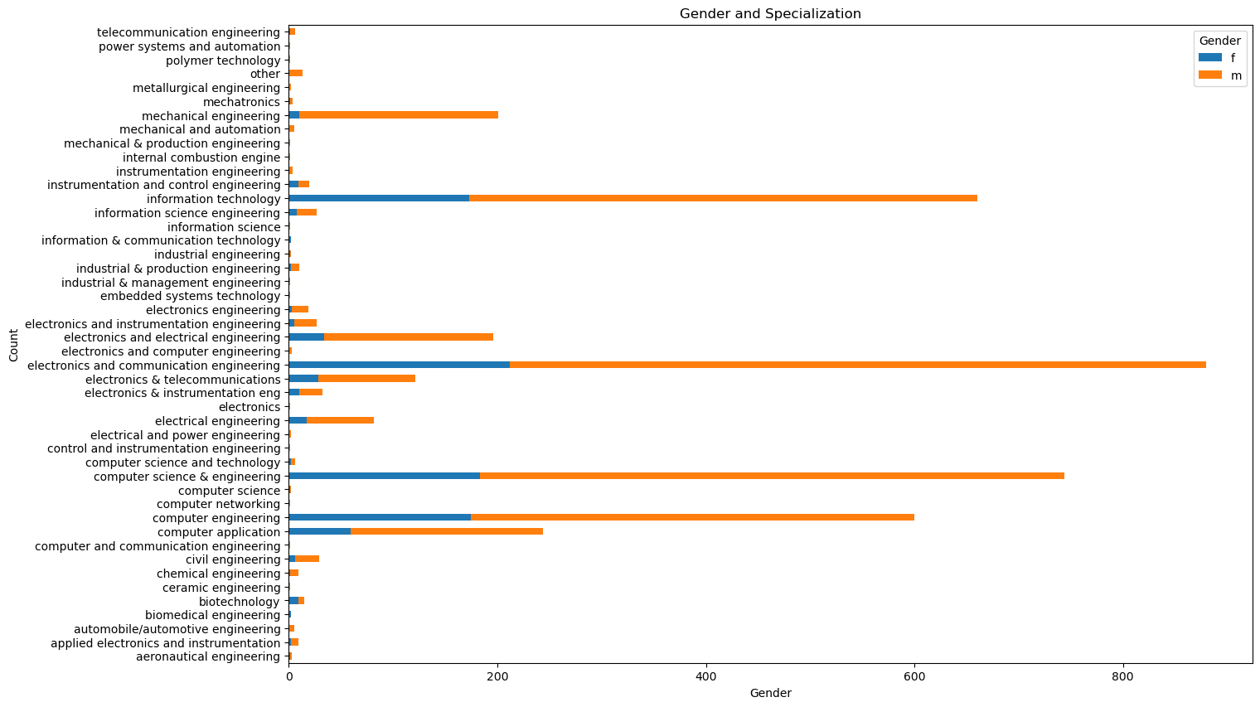
Research Questions
Is there a relationship between gender and specialization? (i.e. Does the preference of Specialisation depend on the Gender?)
It can be seen that the Specializations are male dominated, and in some specializations females are relatively concentrated, so yes the preference of specialization is usually influenced by gender
Also note that in the biotech specialization, there are more females than males and in some others no females at all

Slide 7
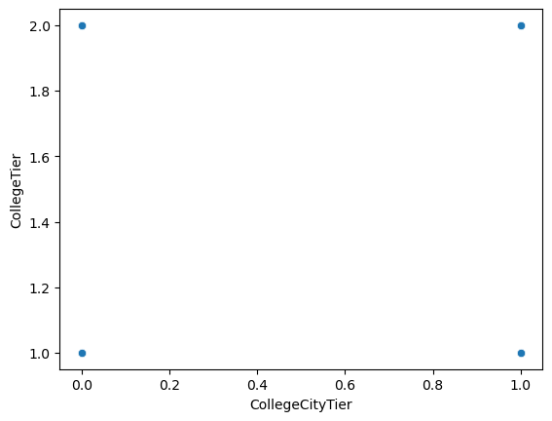
Research Questions
Times of India article dated Jan 18, 2019 states that “After doing your Computer Science Engineering if you take up jobs as a Programming Analyst, Software Engineer, Hardware Engineer and Associate Engineer you can earn up to 2.5-3 lakhs as a fresh graduate.” Test this claim with the data given to you
After analysing it was found out that even 25% of these engineers earn over 3 lakhs so the claim by times of india article was true
In total only 2 fresh graduates earn up 2.5 lakhs
Further Research
Checking for the relationship btw college tier and collegecitytier in order words checking to see if the colledge city tier has an influence on the colledgetier
It can be seen that there are no relationships between both variables

Slide 8
Conclusion
The research question was true because only 2 fresh graduates earned 2.5-3 lakhs

Slide 9

THANK YOU

